Slide 1
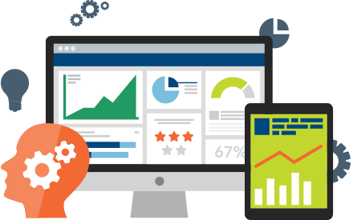
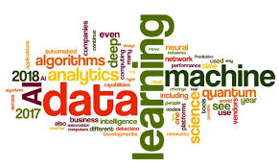

Mr.K.Venkateswara Rao Associate Professor of CSE
Big Data Analytics
CMR COLLEGE OF ENGINEERING & TECHNOLOGY
(AUTONOMOUS)
KONDLAKOYA,MEDCHAL ROAD,HYDERABAD-501401

Slide 2
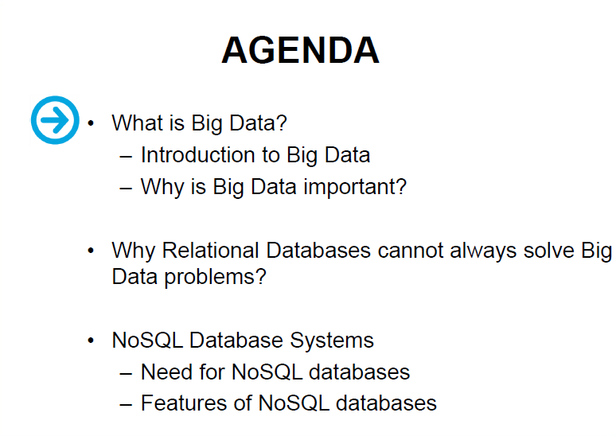

Slide 3
Introduction to Big Data
If you think of the world around you, there is an enormous amount of data generated, captured, and transferred through various media—within seconds.
Some reports have recorded that in 2002, there was an estimated 5 exabytes of online data in existence.
By 2009, that number had risen to 281exabytes -a 56-times increase- and this number has multiplied exponentially post 2009.

Slide 4
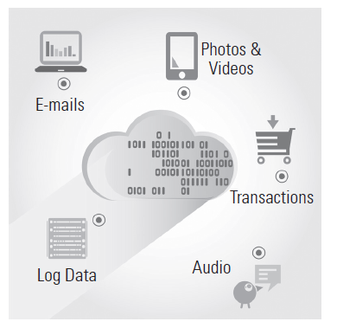
Introduction to Big Data

Slide 5
Introduction to Big Data
This accumulation results in continuous generation of an enormous volume of data.
if analysed intelligently, can be of immense value, as it can give us a variety of critical information to make smarter decisions.
In other words, careful analysis can transform this data to information, and information to insight.

Slide 6
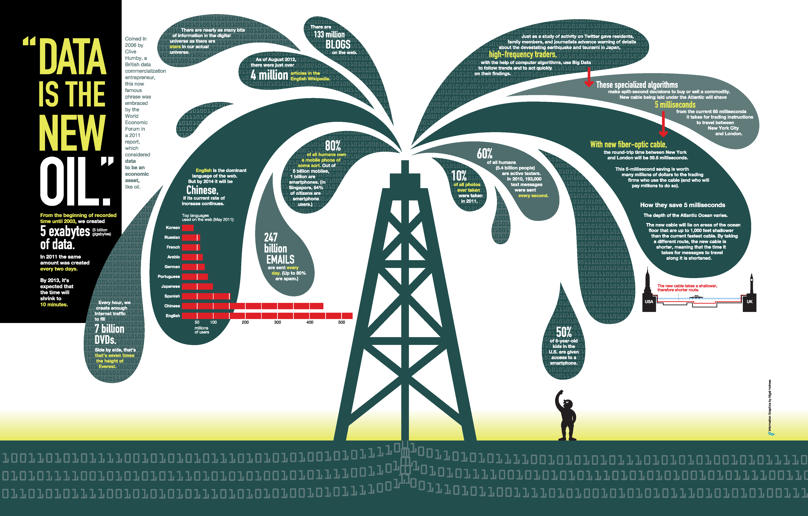
“Data is the New Oil” – World Economic Forum 2011
Notes:
“Data is the new oil." Coined in 2006 by Clive Huby, a British data commercialization entrepreneur, this now famous phrase was embraced by the World Economic Forum in a 2011 report,
All human generated information up to 2003 is 5 exabytes. Same amount of data was generate every 2 days in 2011 and would be every 10 min NOW.
Data is just like crude oil. It’s valuable, but if unrefined it cannot really be used. It has to be changed into gas, plastic, chemicals, etc to create a valuable entity that drives profitable activity; so must data be broken down, analyzed for it to have value.

Slide 7
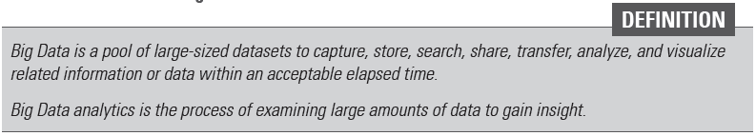
What is Big Data?

Slide 8
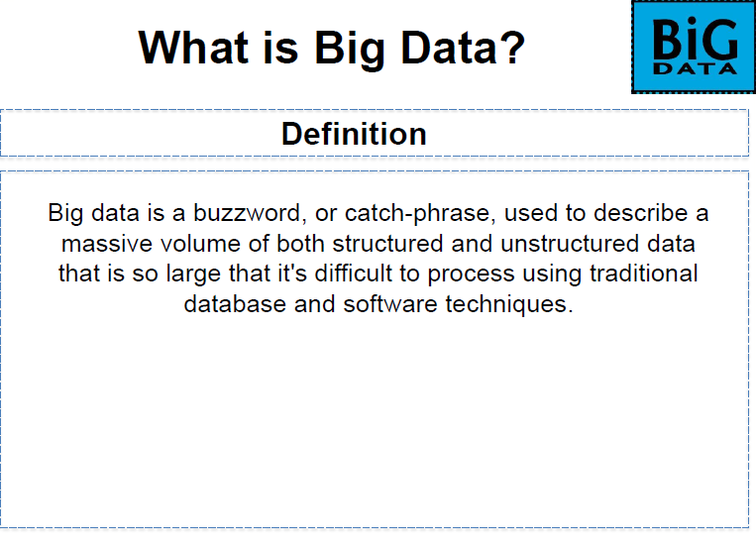

Slide 9
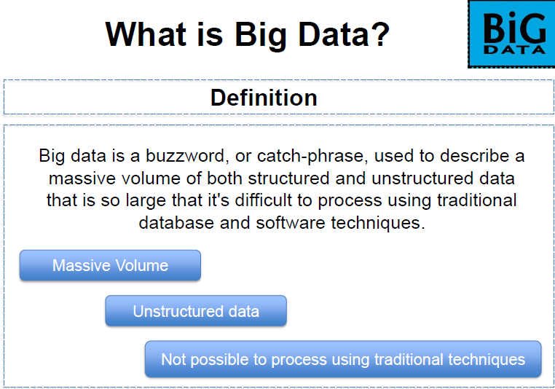

Slide 10
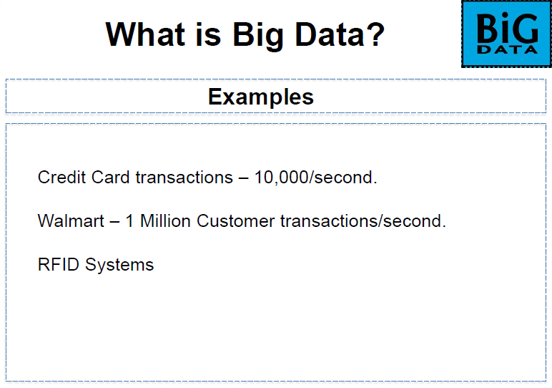

Slide 11
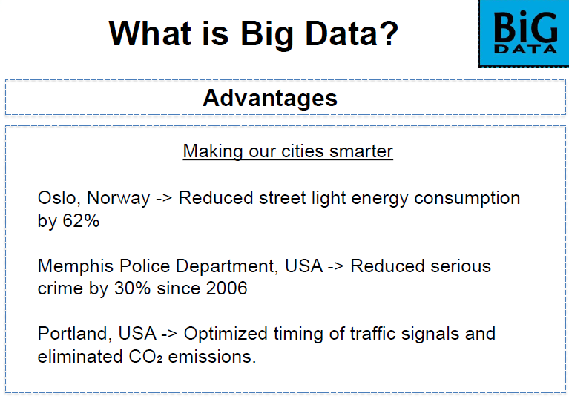

Slide 12
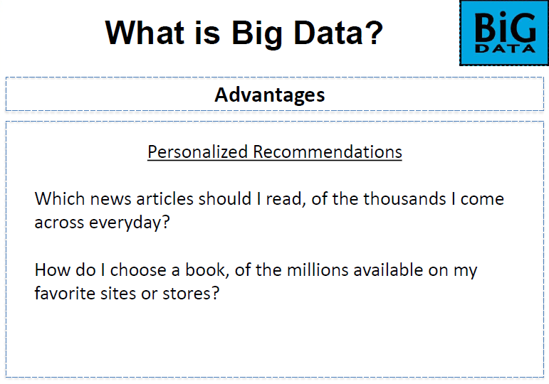

Slide 13
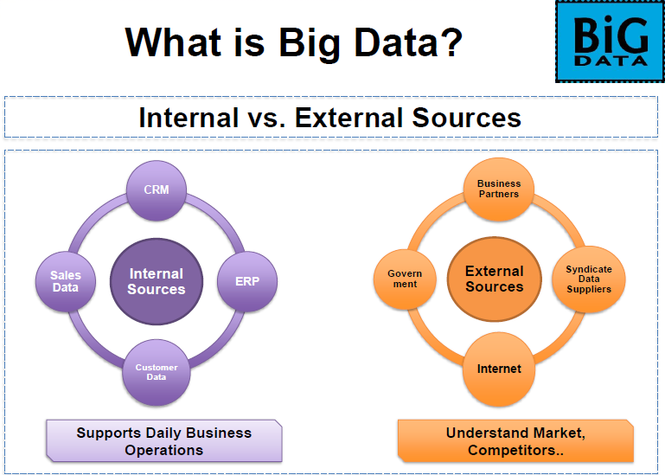

Slide 14
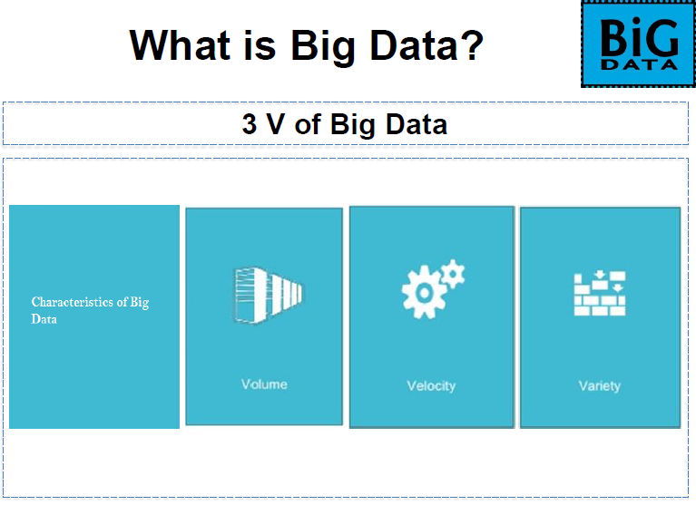

Slide 15
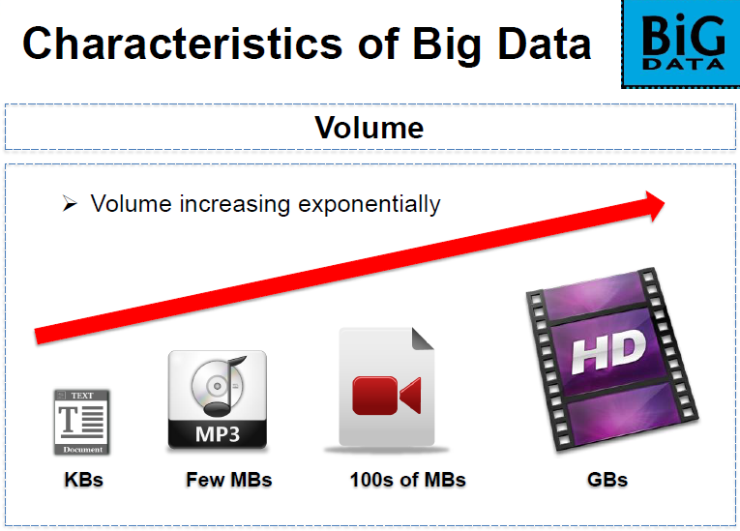

Slide 16
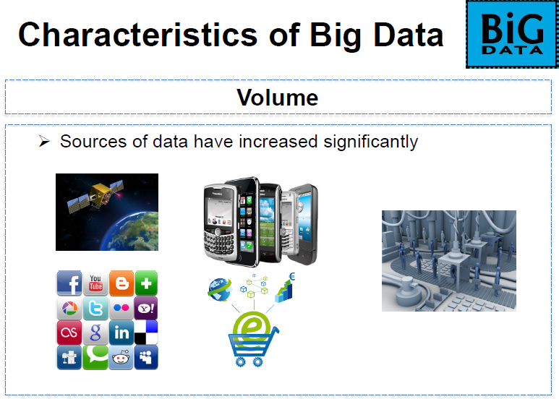

Slide 17
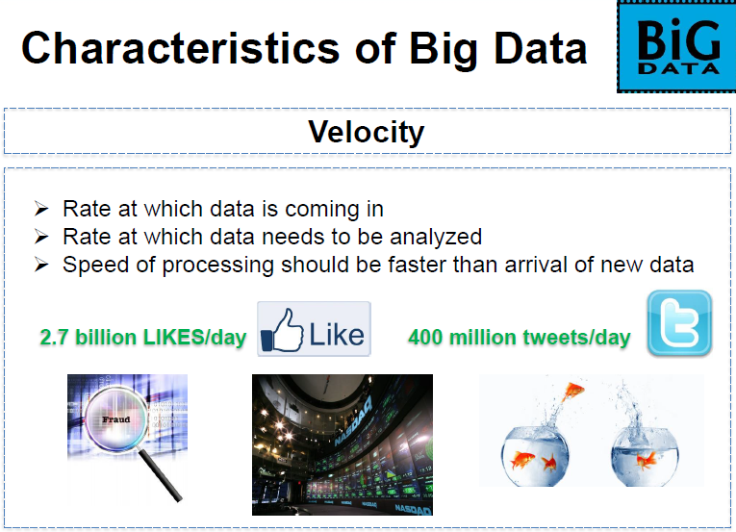

Slide 18
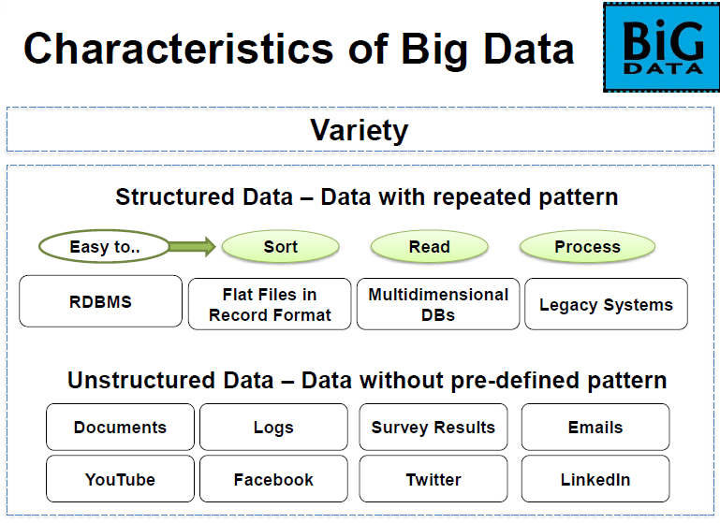

Slide 19
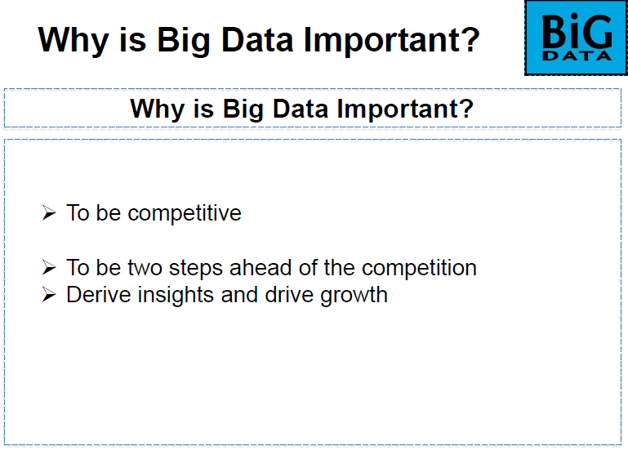

Slide 20
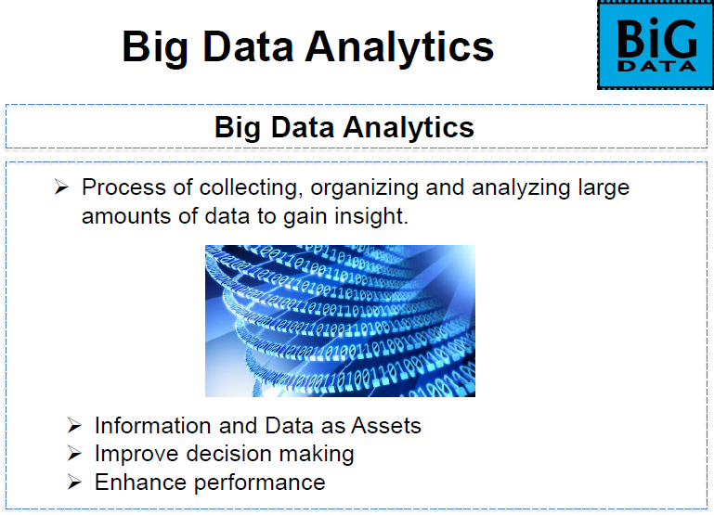

Slide 21
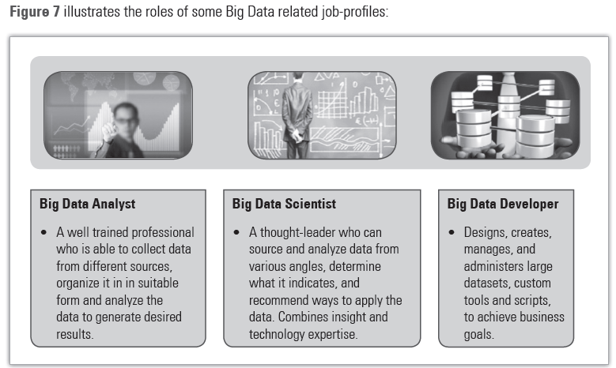

Slide 22
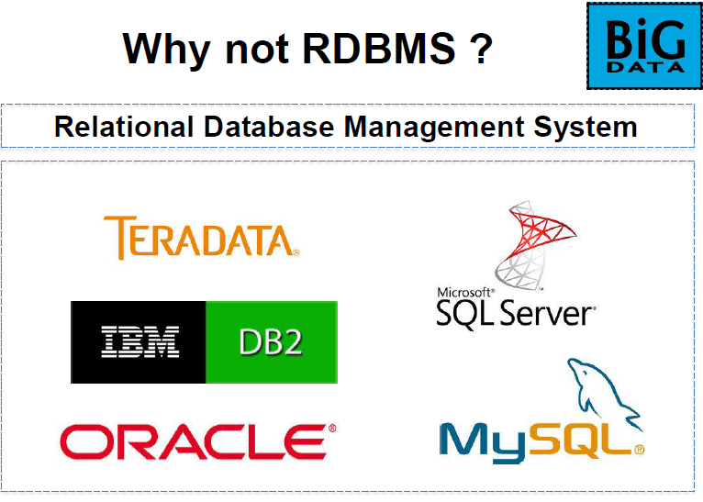

Slide 23
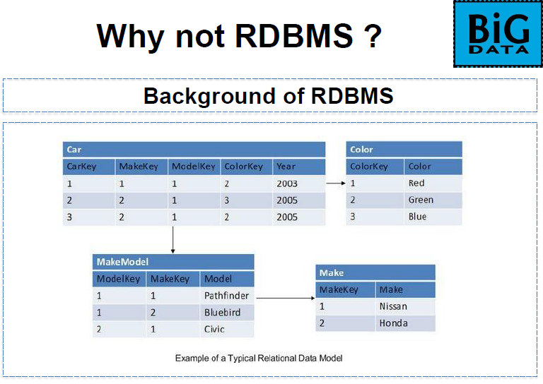

Slide 24
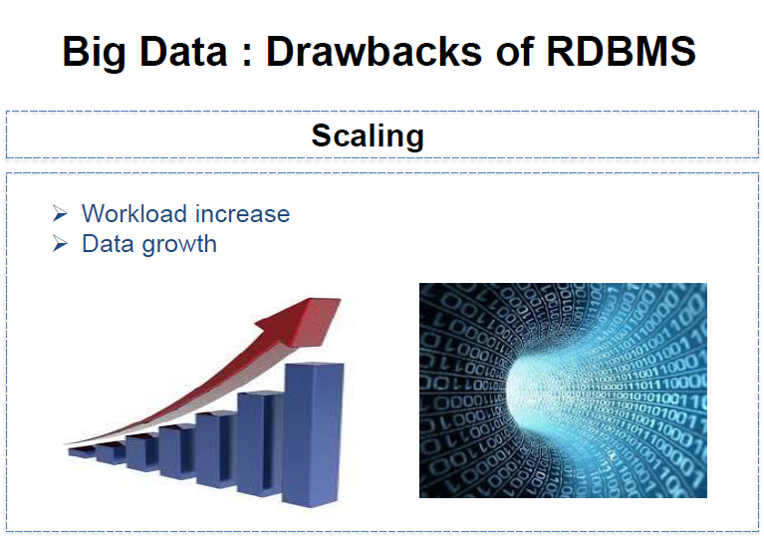

Slide 25
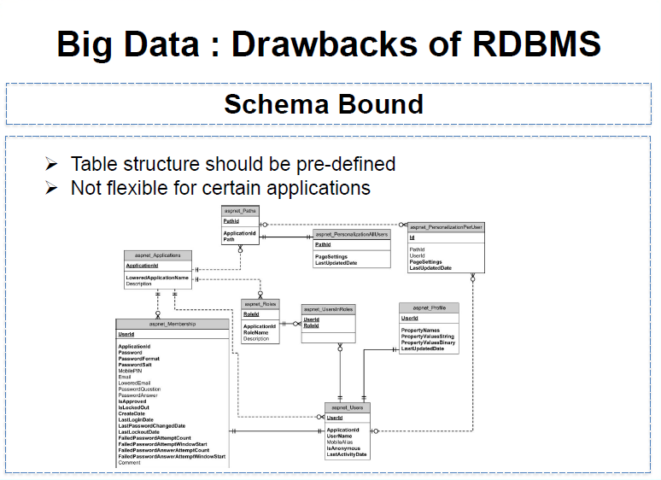

Slide 26
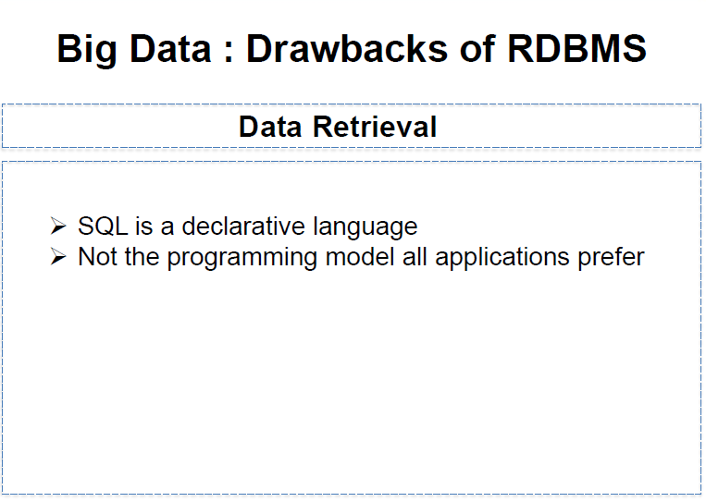

Slide 27
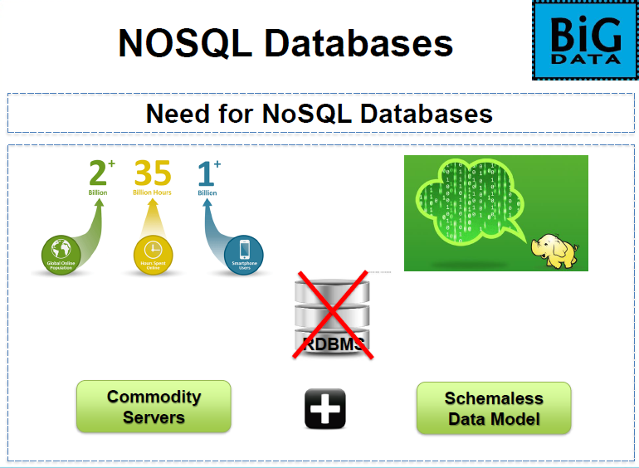

Slide 28
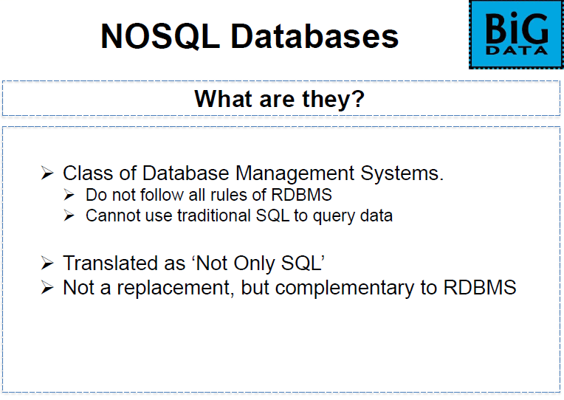

Slide 29
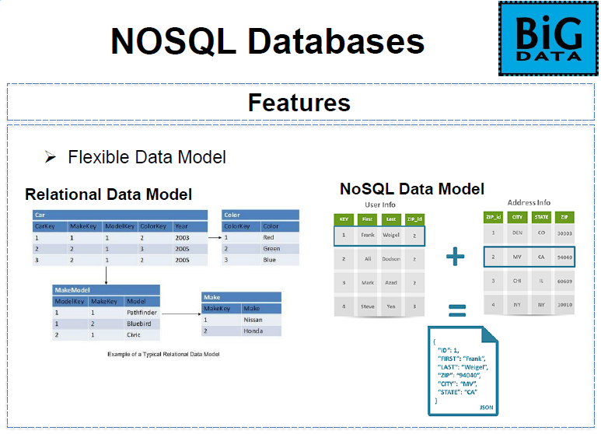

Slide 30
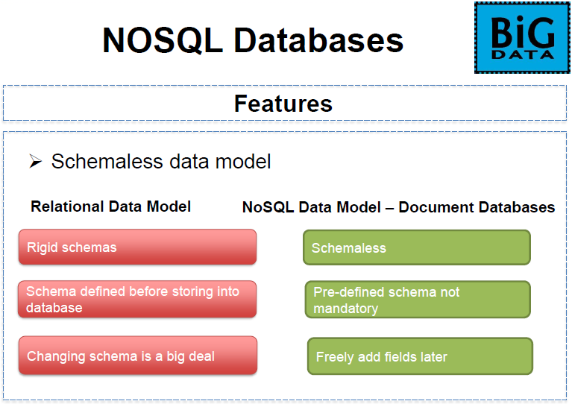

Slide 31
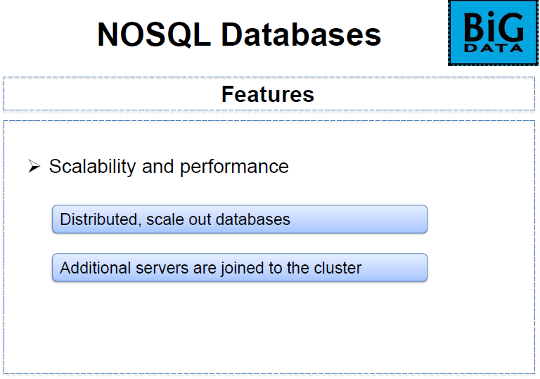

Slide 32
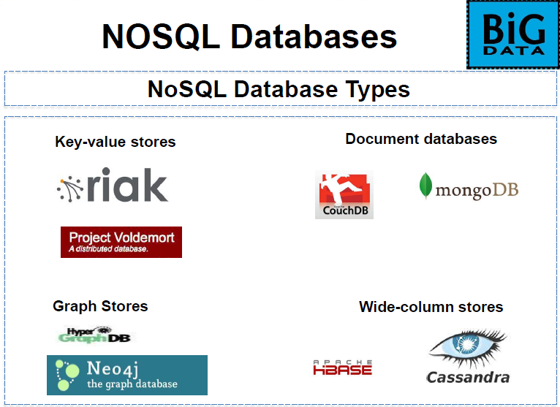

Slide 33
Big Data Analytics Applications
If a decision cannot be made within that timeline, it becomes useless.
As a result, it is important to make all data necessary for such decision available in a timely fashion and that the analysis is done in a fast and reliable way.
There are different real-time big data analytics applications.

Slide 34
Intelligent Transportation
The roads and vehicular sensors can generate big data that can be utilized to provide advanced intelligent transportation services in big cities.
One example of such services for end users is a real-time service that provides information about shortest-time routes to any destination from the current location based on the current traffic conditions

Slide 35
Financial Market Trading
Huge amounts of financial data are generated every second for stock and option trades from multiple markets.
This data is not only big but also very dynamic.
Companies and organizations can use this dynamic big data to detect opportunities and threats and to quickly react to them.
Examples of these opportunities are:
predicting increases or decreases in prices of some securities before a change actually occurs.
The timely reaction to such opportunities can be buying securities before their prices increase or selling some before the prices drop.

Slide 36
Crowd Control
Crowd control is important for police and emergency response teams when large events take place.
Examples of such events are major sports games, concerts, parades and outdoor celebrations like New Year’s Eve.
Being able to watch and predict crowd movements and make immediate decisions such as opening more parking lots, closing some streets to facilitate pedestrian movement, or increasing police presence in some areas becomes important.

Slide 37
Military Decision Making
Wars are very dynamic and complex.
The key to winning a war is not only strength but also the ability to collect correct information about the current situation and make the right and decisions quickly .
In wars hundreds of different equipment, vehicles, structures and communication systems are used.
Military vehicles can be tanks, armored vehicles, transportation and logistics vehicles, manned and unmanned aircrafts, military boats and ships, and underwater vehicles. This equipment, vehicles, and other resources in addition to thousands of soldiers can be in different locations.

Slide 38
Smart Grid
A smart grid is a renovated electrical grid system that uses information and communication technology to collect and act on available data, such as information about the behaviors of suppliers and consumers, in an automated fashion to add some values .
It improves the efficiency, reliability, economics, and sustainability of the production and distribution of electric power.

Slide 39
Early Warning for Natural Disasters
Early warnings of natural disasters can save the lives of thousands of people.
Early warning systems involve time-critical processing of huge distributed data collected in real-time from ground sensors, underwater sensors, remote sensors such as those installed in unmanned aircraft vehicles and satellites with other data such as weather information, geographic or area maps to predict where the natural disaster will happen .
One example of such systems is the Indian Tsunami Early Warning System , which involves sensors for earthquake detection, ocean-based sensors to detect tsunamis, satellites to associate weather information, and geographic area maps to identify where the tsunami will strike.

